Slide 1
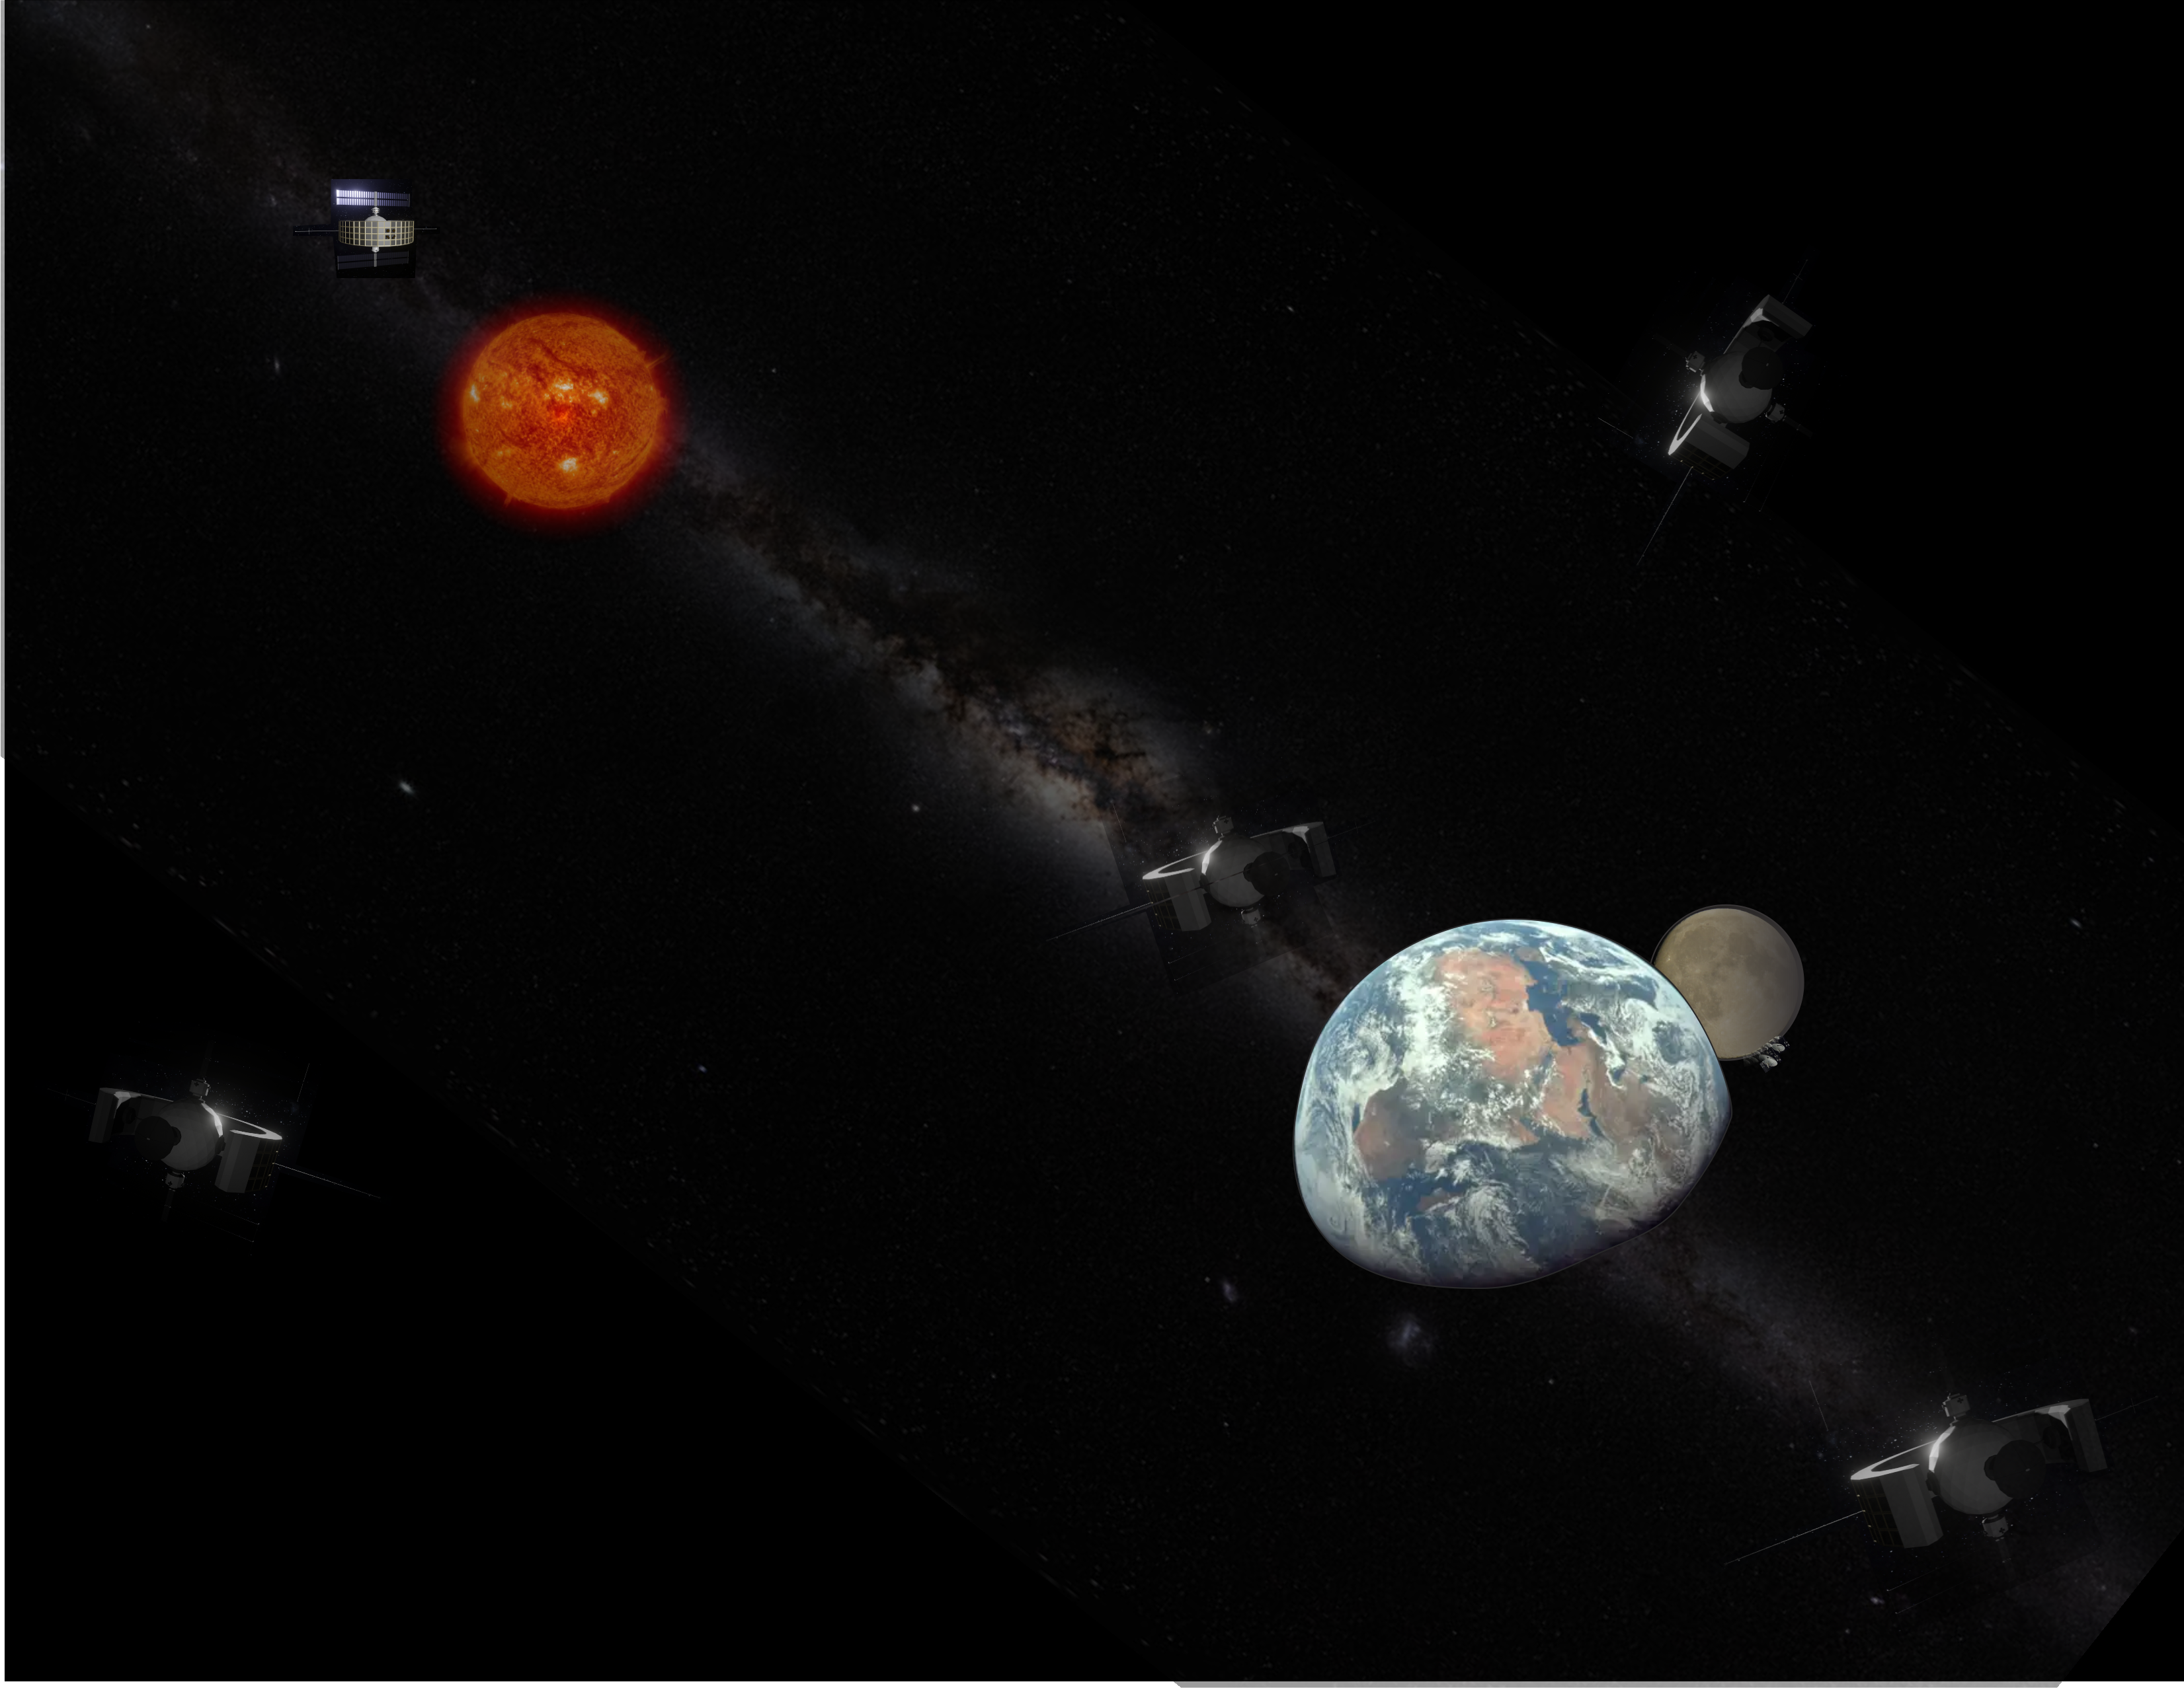

The Future of Human and Space Research: The Lagrange Communication Advanced Realtime Space-weather (LCARS) Array A NASA Mission Concept
Presented by
Dr. Jerry W. Manweiler – Fundamental Technologies, LLC, Lawrence, KS (KU:PhD-’97,MS-’87,BS-’85)
For the University of Kansas Department of Physics and Astronomy SpaceFest - 2025
In honor of the retirement of Prof. Thomas E. Cravens and Prof. Hume Feldman
© 2025 – Fundamental Technologies, LLC; All Rights Reserved; Do Not Duplicate without Prior Written Permission - 1 -

Slide 2
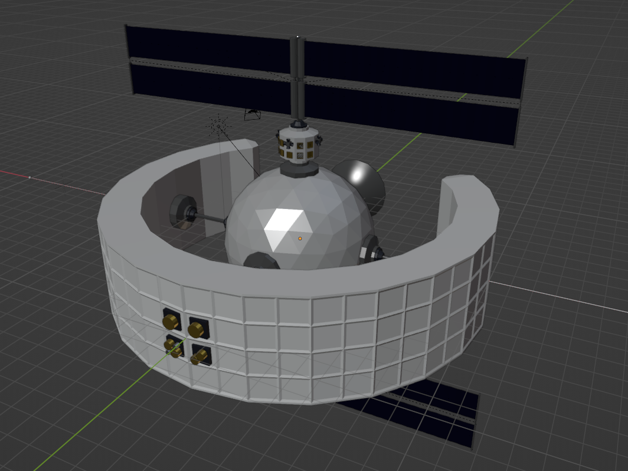





LCARS Array website and Publications https://LCARS.FTecs.com
Decadal White Paper AGU 2022 Poster AGU 2023 Poster
AGU 2024 Poster LCARS Website
© 2025 – Fundamental Technologies, LLC; All Rights Reserved; Do Not Duplicate without Prior Written Permission - 2 -

Slide 3
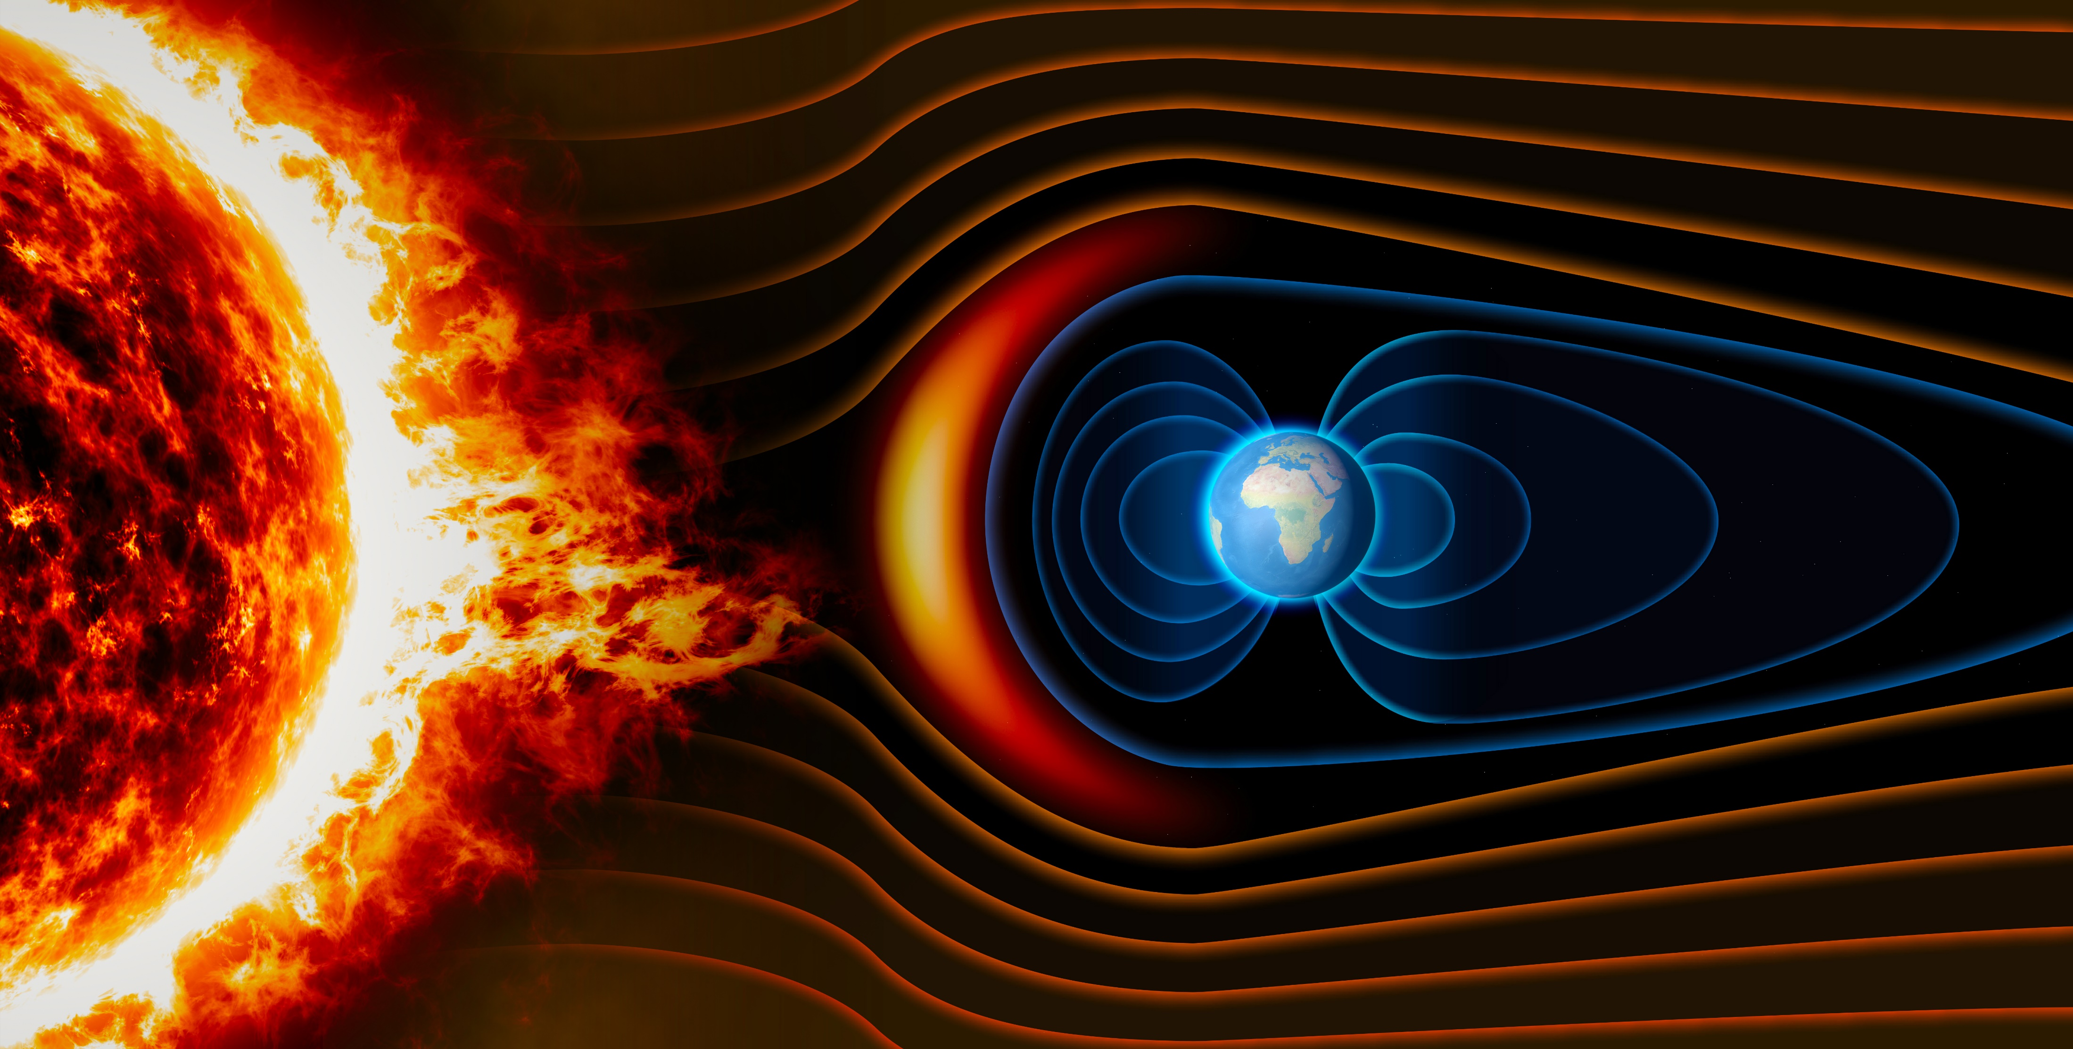
LCARS Array Vision Driving Question
In 2020 Dr. Nicola Fox held the NASA’s Heliophysics 2050 Workshop’s and asked the question:
What should Humanities Space Exploration and Expansion into the Solar System look like by the year 2050?
Assumptions:→ → → By the year 2050 there will be← ← ←
A Lunar Base with extensive communications capabilities
Humans on Mars – and since they won’t be coming back, we call that a Base!
Significant expansion of NASAs Heliophysics System Observatory by sending multiple different spacecraft to the outer planets, to Mars, to the Asteroid belts, etc.
Interstellar Probe will be on its way and New Horizons will still be working
(Note: Voyager unfortunately will be dead in the VLISM)
© 2025 – Fundamental Technologies, LLC; All Rights Reserved; Do Not Duplicate without Prior Written Permission - 3 -

Slide 4
Why the LCARS Array – Now?
What are the problems of the present and near future that need to be addressed?
Data and Communications
Manned Exploration of the solar system requires a large volume of data to be constantly streamed from all of the missions back to earth
The Data volume by current (and to be flown) NASA missions has exploded exponentially heading into the 10’s of TB / day
Instrument capabilities are limited by bandwidth even with modern compression algorithms (lossless or lossy)
High bandwidth Communications is very limited through Earth’s atmosphere
With some success, the recently tested Laser communications is also has issues due to need to maintain pointing
Space weather and Solar Science
Understanding of The radiation environment in space otherwise called, Space weather, is critical to human exploration
The number of historical and current missions in support of space weather research has allowed us a fundamental understanding of the overall impact that the Sun has on Earth's systems
The ACE, SOHO, WIND, STEREO A/B ,Solar Probe and Solar Orbiter missions providing discoveries beyond their original mission goals, but they can’t see the “whole” sun all the time
Space weather modeling accuracy demands a “whole” sun view allowing incremental and sometimes significant improvement in the ability to accurately predict times when Earth space assets are at risk as well as future Human assets in the solar system (Mars etc.)
There is critical need for highly accurate space weather predictions for human presence on the Moon and Mars since both bodies spend significant amount of time in the Solar Wind exposed to Space Weather without a magnetic shield
So…
© 2025 – Fundamental Technologies, LLC; All Rights Reserved; Do Not Duplicate without Prior Written Permission - 4 -

Slide 5
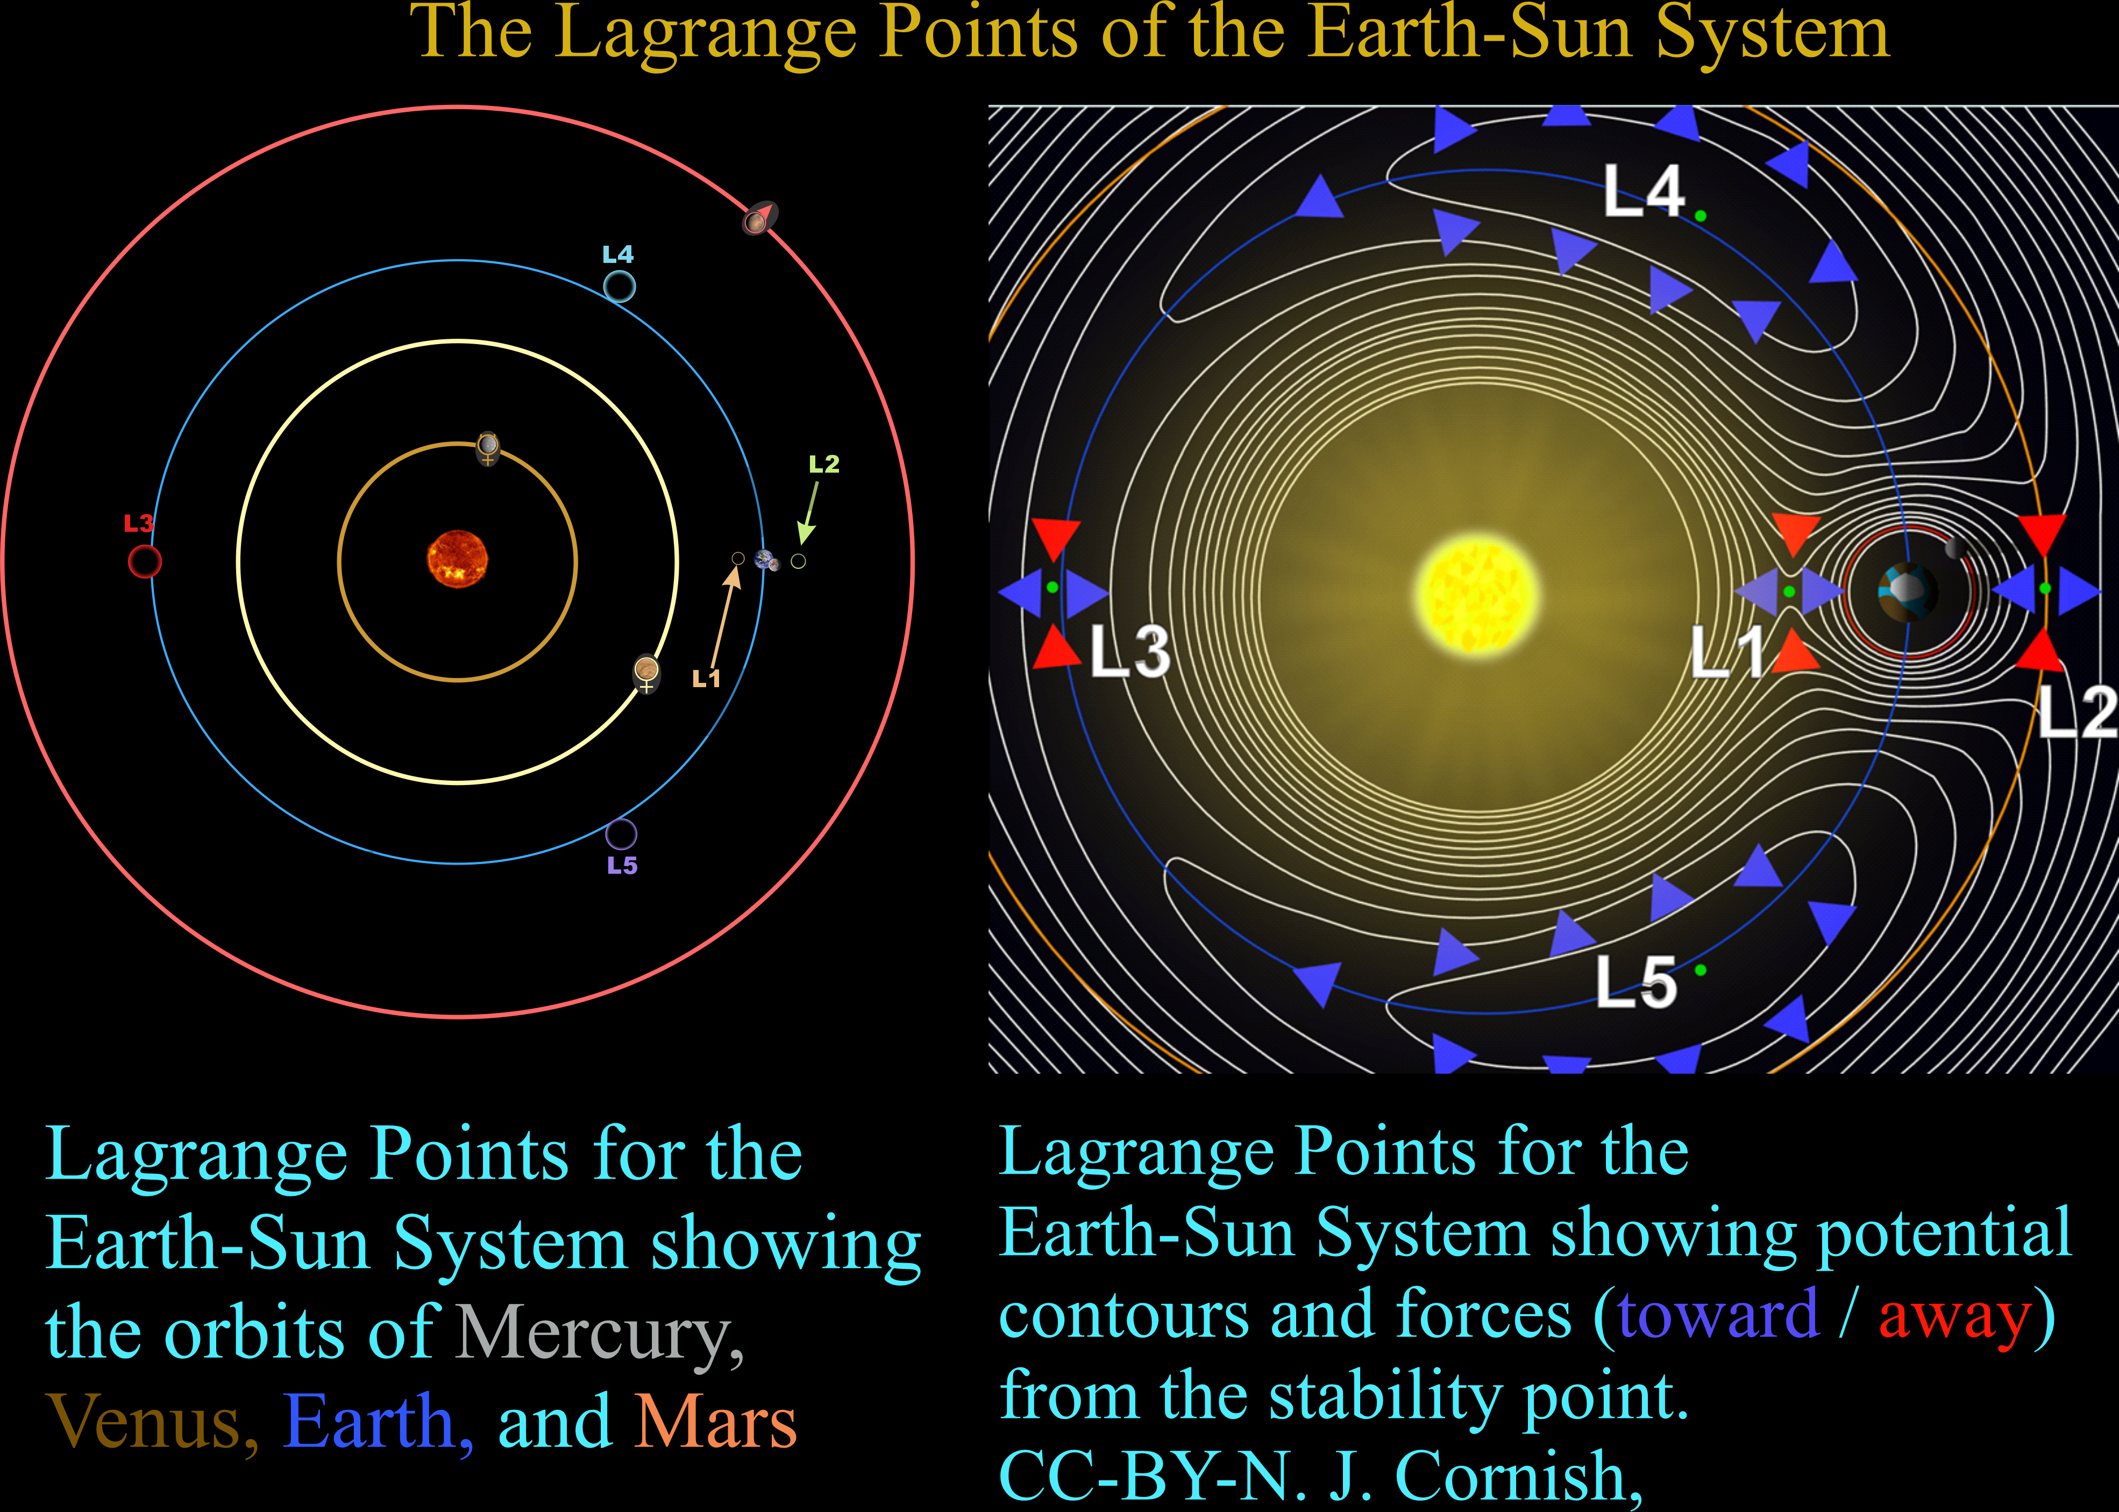
The LCARS Array – the Lagrange Points
Lagrange Points for the Earth-Sun System showing the orbits of Mercury, Venus, Earth, and Mars
© 2025 – Fundamental Technologies, LLC; All Rights Reserved; Do Not Duplicate without Prior Written Permission - 5 -

Slide 6
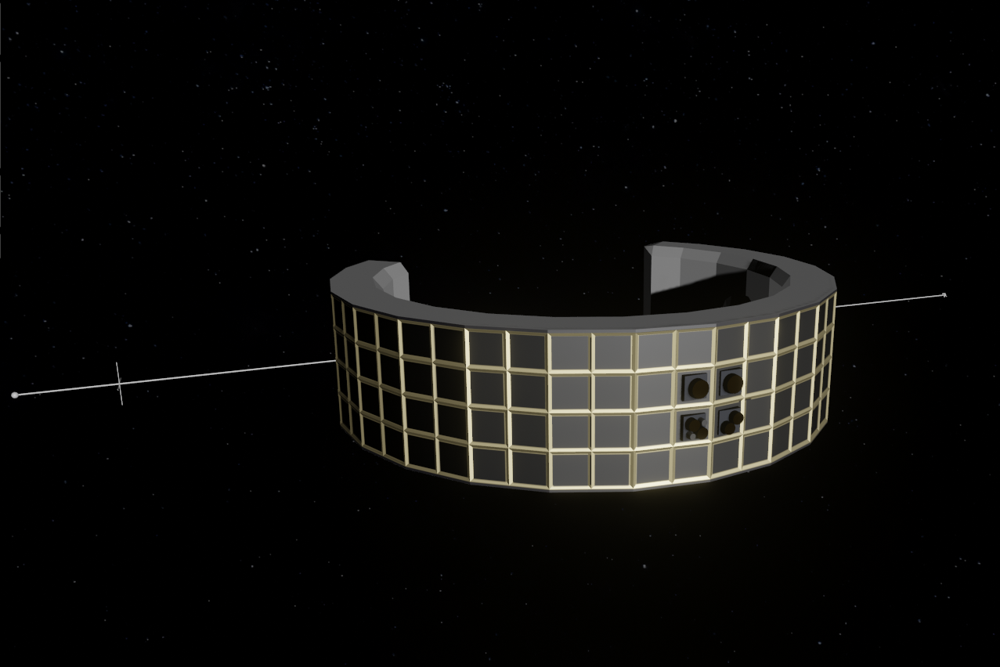
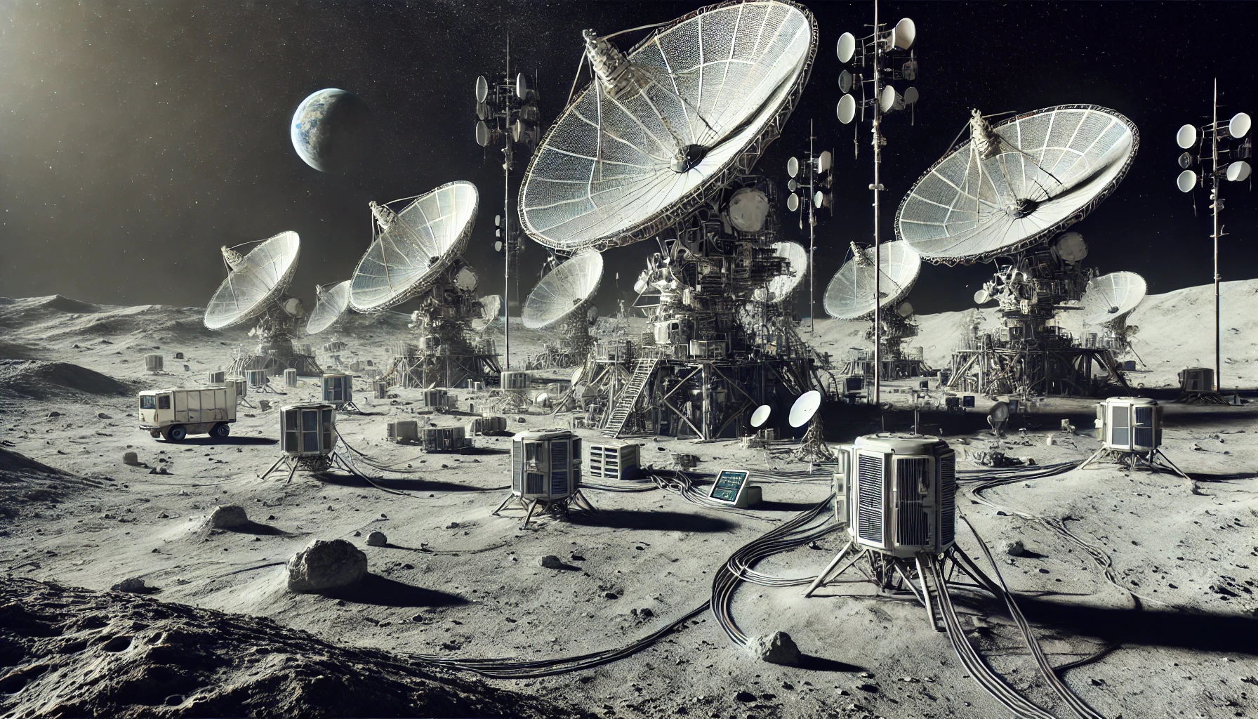
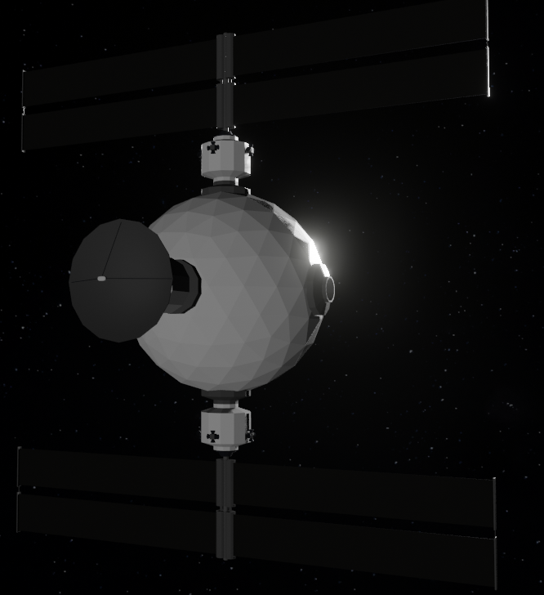
LCARS Vision
L3 is behind the sun and can see L4 and L5, offers communications for missions obscured by sun
Space Platform (station) at each of the Earth-Sun Lagrange Points
L4 has unobstructed view of L3 and sits upstream of Space Weather flow along the Parker spiral
The SOL-Network is an Interstation communications Network using Terahertz/Laser comms with AI based packet networking
Each station includes Advanced modular multi-bay Solar and in-situ instruments with Ejectable and dock able sensors Observation Platform shields comms unit
Idealized Lunar Communications
L1 is an upstream Space Weather Detector
L5 has unobstructed view of L3 and sits downstream of Space Weather flow along the Parker spiral
Earth-Lunar Comms
Advanced Station Comms: Multi-frequency Multi-channel
Terahertz/Laser Network Comms
Advanced Gimbled Deep Space Dish
L2 is protected and offers redundant comms
© 2025 – Fundamental Technologies, LLC; All Rights Reserved; Do Not Duplicate without Prior Written Permission - 6 -

Slide 7
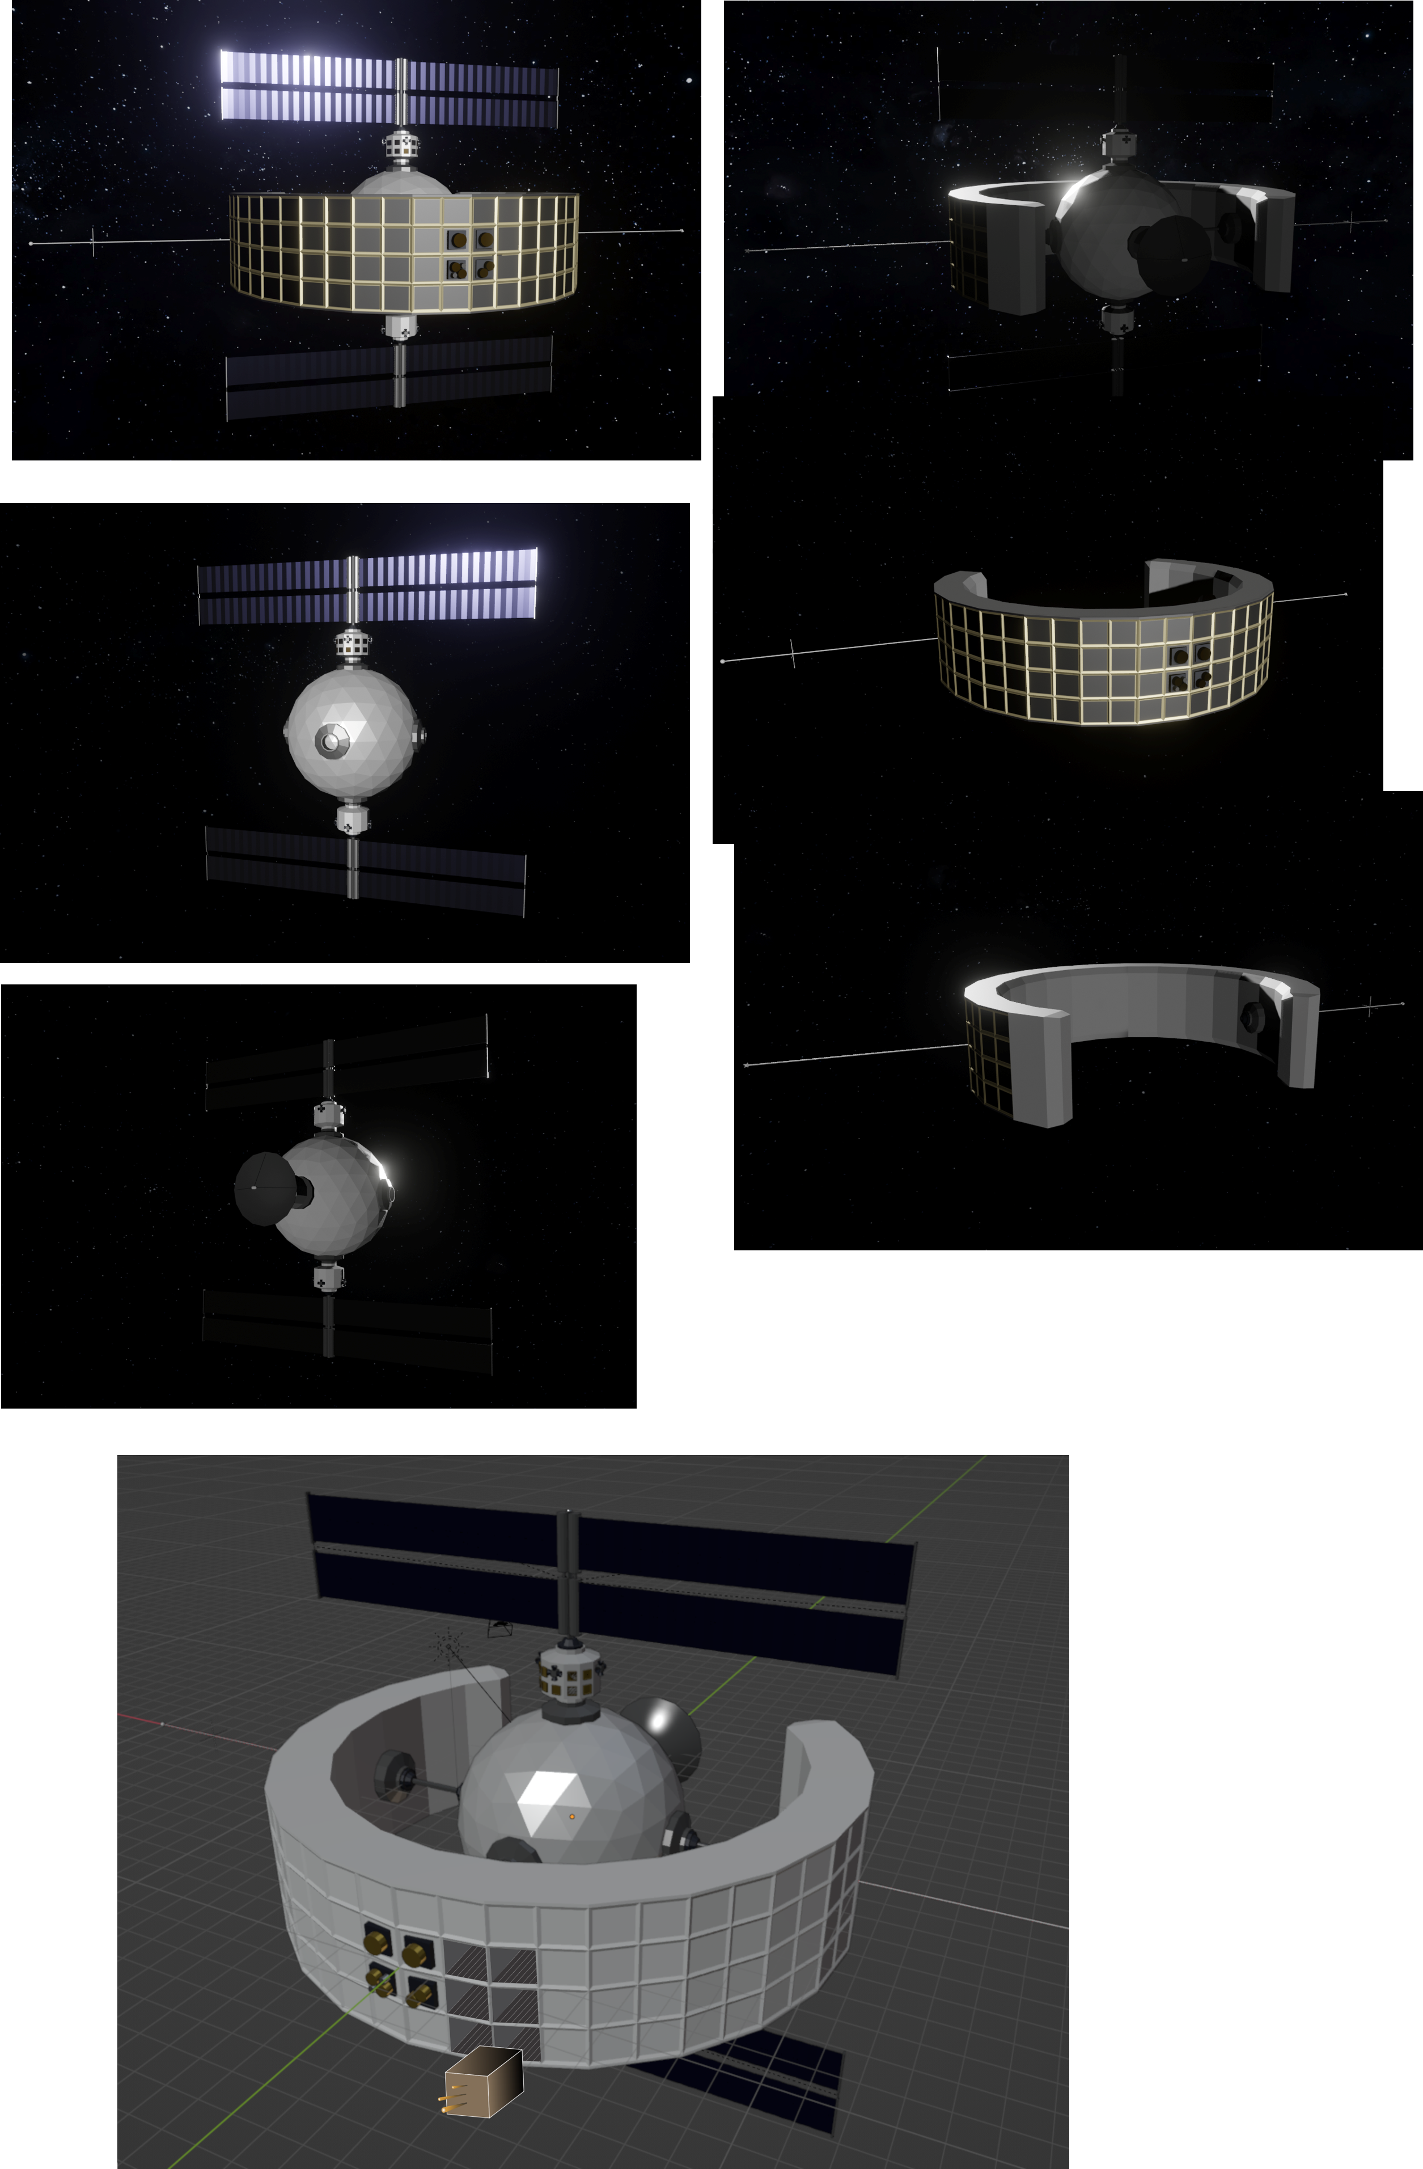
The LCARS Array – the Spacecraft Concept
The LCARS Array Spacecraft Concept
Novel Spacecraft Development
100 Year Mission Lifetime Goal
Multi-Component Modular Spacecraft
One or more transport rockets to units'
Station Keeping engine at final destination
Modular Spacecraft Design with Self Assembly capability
Separate Communications and Sensor Sections
Communications Section
Inter-SC COMM (Laser +Terahertz)
Multichannel/Multifrequency Radio Comms
Gimbled Deep Space Communications
Sensor Section
Current Sizing: 4 m tall x 2-3 m deep
Sensor Section SHIELDS the Communications Array!
Modular Instrument Bays, 4 m tall x 28 m
1 m² sections divided as 1 dm² units
Power and Data per unit
Up to 100 units per section and 2800 total units
Direct Solar Telescopes with continuous recording
In-Situ Solar Wind Instruments with continuous recording scattered throughout the available bays
Stellar telescopes instruments on available side and rear looking bays
2-3 meters deep
4 meters tall
Data and Command and Control Systems
© 2025 – Fundamental Technologies, LLC; All Rights Reserved; Do Not Duplicate without Prior Written Permission - 7 -

Slide 8
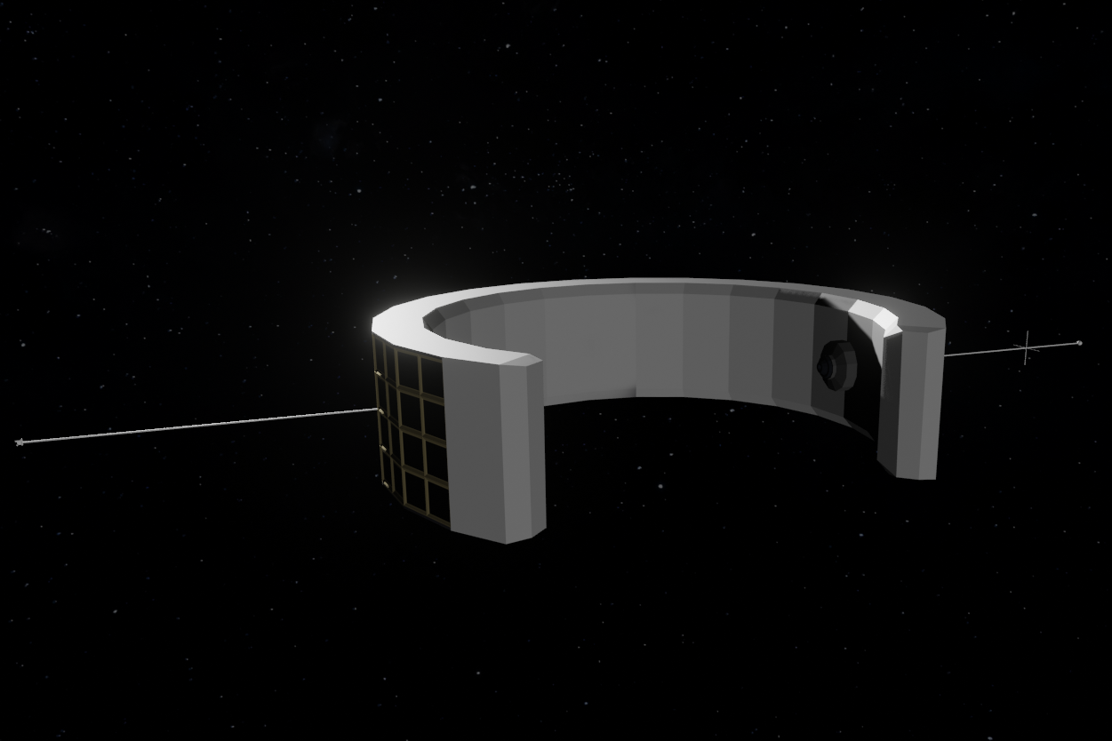
The LCARS Array – the Instrument Deck
The LCARS Array Spacecraft Concept
Instrument Section
Modular Instrument Bays
Direct Solar Telescopes with continuous recording
Photospheric Imager
Solar Magnetograms
Coronal Imager
Coronal Spectrogram
etc.
In-Situ Solar Wind Instruments with continuous recording
Cosmic Ray Particle Detectors
Plasma Sensors, e.g.
Top-Hat Detectors
Langmuir Probes
Magnetic Field Antennae and Internal Sensors
Electric Field Antennae and Spacecraft Charging Sensors
Rear facing internal outward facing elements provide space for background measurements to calibrate other instruments
© 2025 – Fundamental Technologies, LLC; All Rights Reserved; Do Not Duplicate without Prior Written Permission - 8 -

Slide 9
The LCARS Array – Technology
The LCARS Technology Development
Novel Communication Technologies
Inter-SC COMM (Laser +Terahertz Gimbled)
Autonomous Networking
Hardware:
Terahertz and Laser Communications Systems
Gimbled Deep Space Communications Dish
Multichannel/Multifrequency Radio Comms
Protocols:
Interplanetary Communication Protocols (up to 18 minute packet delays)
Adaptive and Predictive AI protocol evolution
Adaptive Deep Space Dish Capabilities:
Gimbled pointing
Central receiver
Lightweight Dish materials (e.g. Mylar)
Deployable and Retractable Dish
Variable Dish Surface Area w/ R <= 35m
Novel Spacecraft Technologies
Multi-Component Modular Spacecraft
One or more transport rockets to final destination
Station Keeping engine at final destination
Modular Spacecraft Design with Self Assembly capability
Novel Software Systems
Self-writing (AI) Adaptive Software Systems
Self-healing (AI) Redundant Software Systems
Adaptive / Predictive Data Analytics – e.g. Predictive Decision Making onboard each Space station
The LCARS Technology Development
Novel Sensor Module Technologies
Modular Instrument Bays
Self-Docking Modules
Spacecraft ejection of defective modules
Data System Technologies
Large Redundant Data System
Photonic or Quantum Storage Technologies
Large Redundant Data Systems
Self-Healing Hardened Systems
Storage Module Ejection and Replacement
Autonomic Data Management
Novel Power System Capability
Solar Panels used for minimum power requirements
Replaceable Solar Arrays and Fuel Cells
Embedded Fuel Cell Array used for Operations
Primary power for Comms
Power provided per Bay Unit for experiments
Each bay unit provides Vmax power
Coupled bays provide N*Vmax power
© 2025 – Fundamental Technologies, LLC; All Rights Reserved; Do Not Duplicate without Prior Written Permission - 9 -

Slide 10
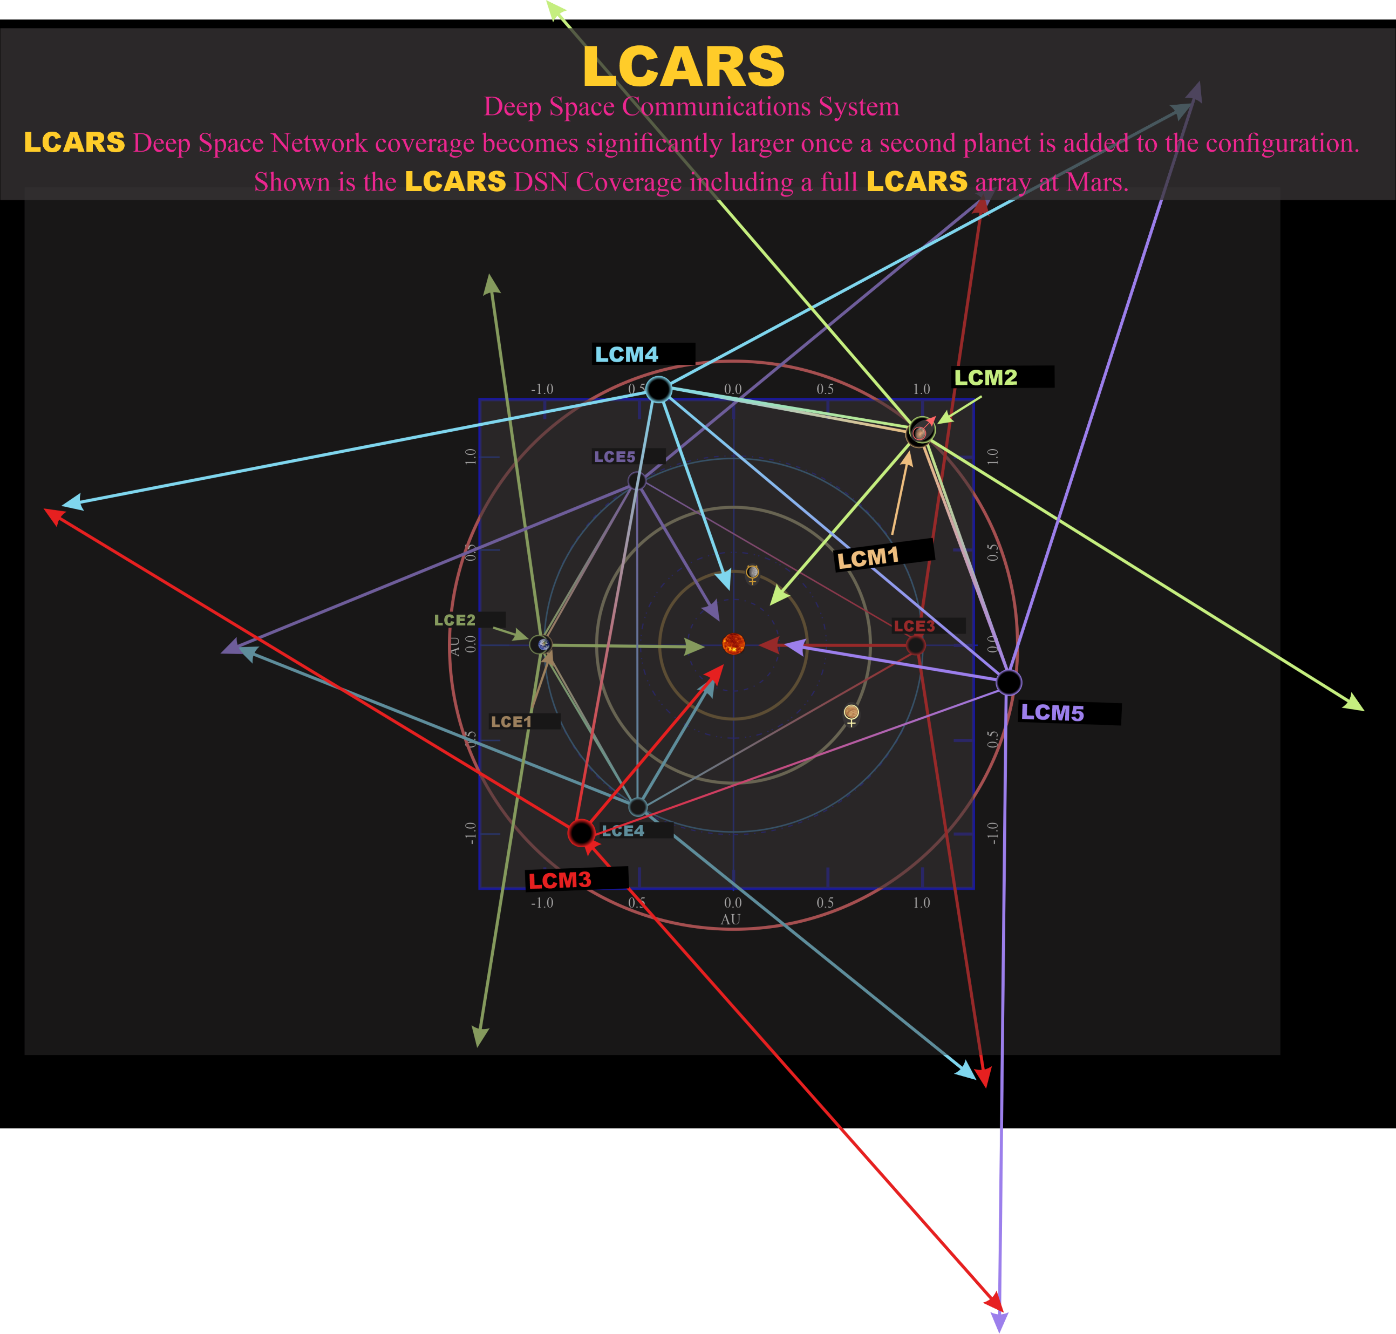
LCARS Array – The Future
LCARS Array – Into the Future
Additional LCARS Array can be deployed at other Lagrange points.
The Earth Moon Lagrange points (trial)
The Mars Sun Lagrange points
Different orbital cadence
Provides the capability to significantly enhance the overall SOL-Network
The orbital period of this LCARS Array would be different providing additional continuous coverage of deep space assets
What about the Mercury Sun Lagrange Points
This would give an LCARS Array Solar Observatory at 0.3 AU (near the current Solar Orbiter distance)
The enhancement to direct and immediate measurement of the in-situ Space Weather would greatly increase the predictive powers of the Space Weather Modeling systems
What about Jupiter, Saturn, Uranus, or Neptune?
© 2025 – Fundamental Technologies, LLC; All Rights Reserved; Do Not Duplicate without Prior Written Permission - 10 -

